Slide 1
ComplexHeatmap
GTK Symposium, 14.06.2022
Mirko Brüggemann

Slide 2
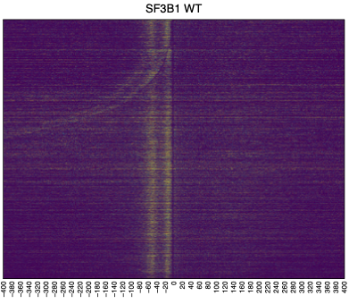
The Challenge: Make the heatmap look nice ☺

Slide 3
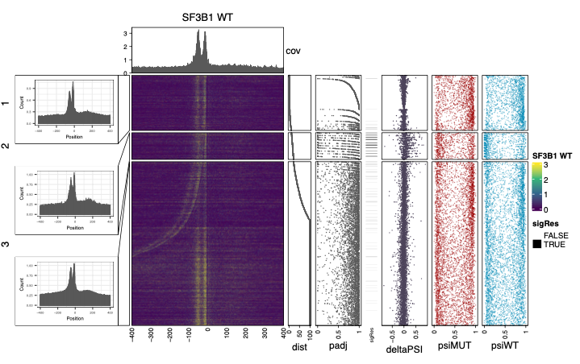
Yes… No… The heatmap
Bar annotation
Link annotation
Point annotation

Slide 4
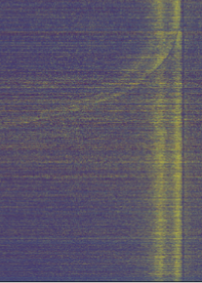
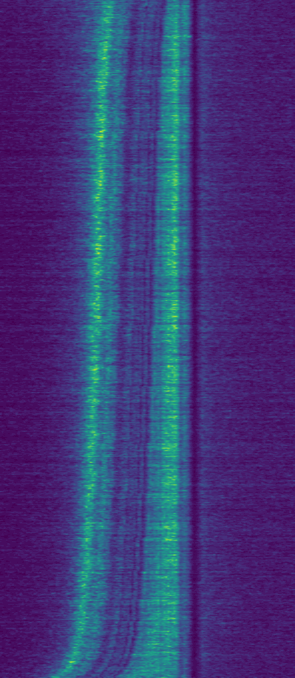
Am I stupid ?_?

Slide 5
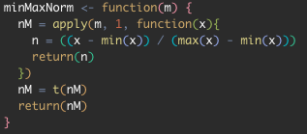
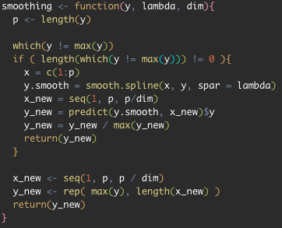
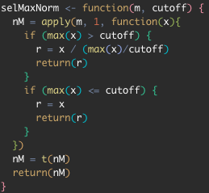
Heatmap data scaling
MinMax
MaxValue
Z-Score
SelMax
Smooting

Slide 6
Heatmap color scaling

Slide 7
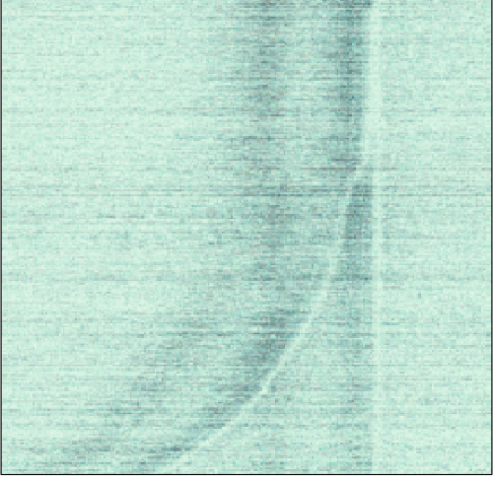
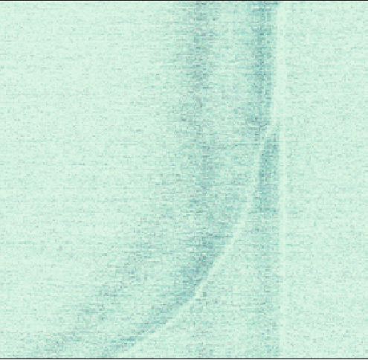
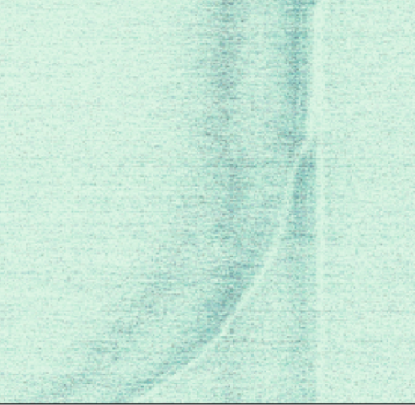
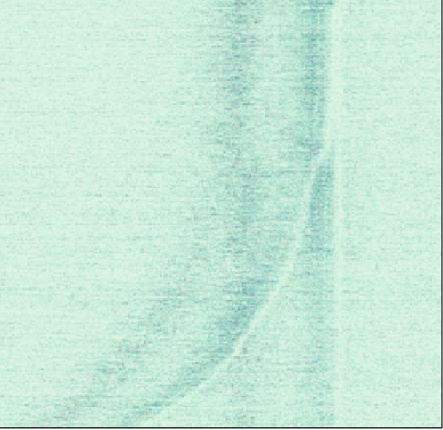

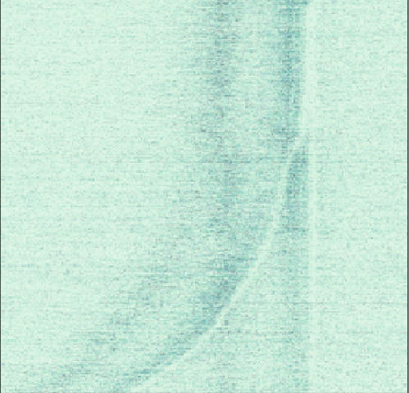
Desperation Phase 1
MaxValue
MinMax
MaxValue + MinMax
SelMax
MaxValue + SelMax
MaxValue + SelMax + MinMax

Slide 8
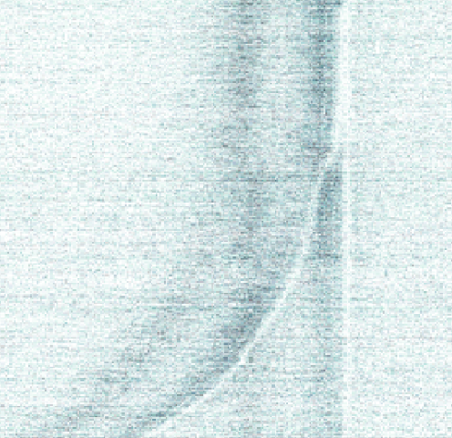
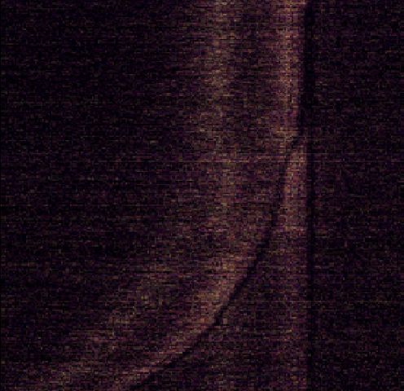
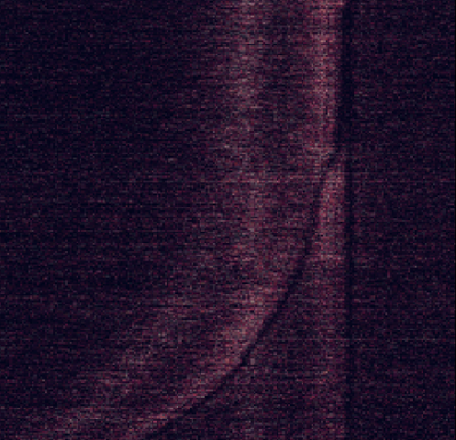
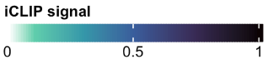
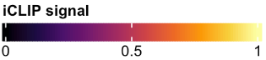
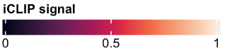
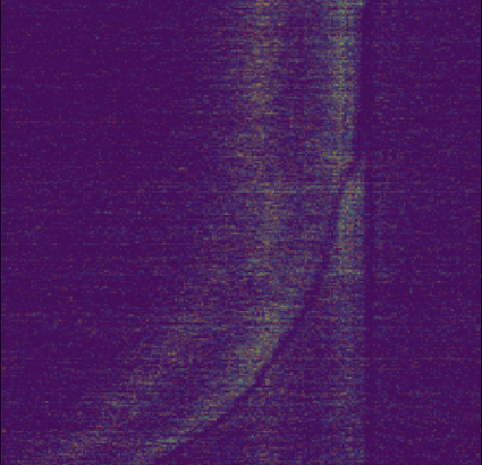
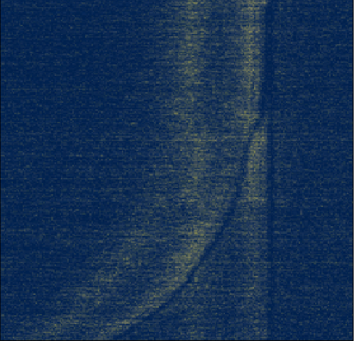
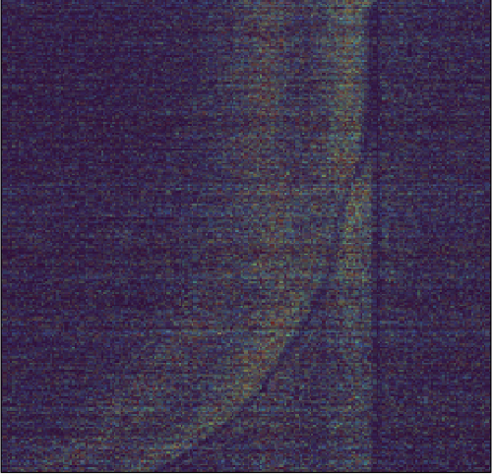
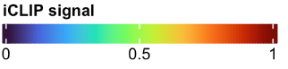
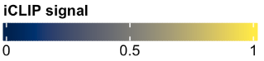
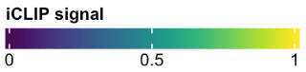
Desperation Phase 2

Slide 9
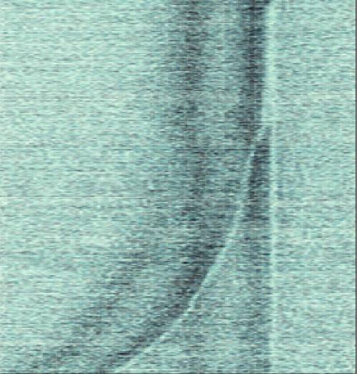
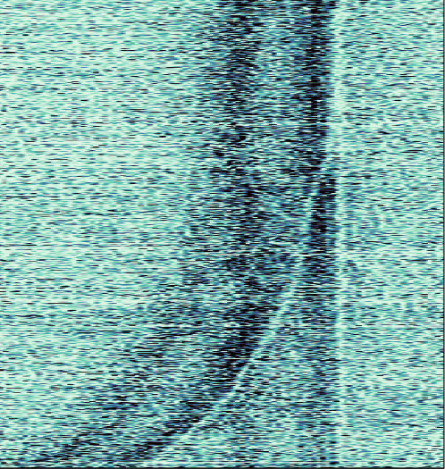
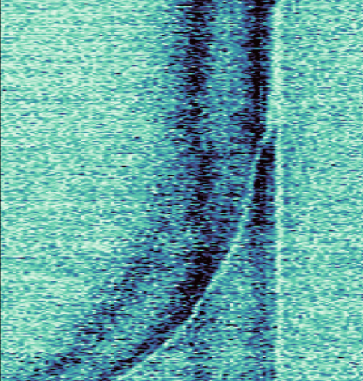
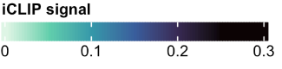
The hidden magic(k)
use_raster = TRUE
raster_quality = 5
raster_resize_mat = mean
use_raster = TRUE,
raster_quality = 1,
raster_resize_mat = mean
use_raster = TRUE
raster_quality = 1

Slide 10
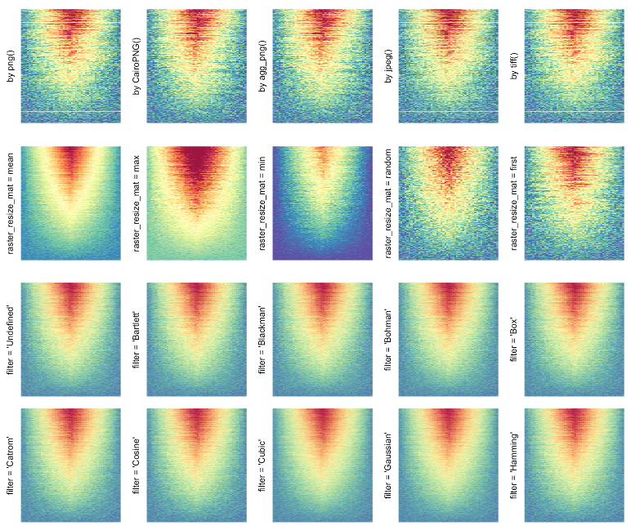
The magick package
Magick: Advanced Image-Processing in R
Turns your heatmap into a rasterized PNG image!
Magick package
https://cran.r-project.org/web/packages/magick/vignettes/intro.html
ComplexHeatmap package
https://jokergoo.github.io/ComplexHeatmap-reference/book/a-single-heatmap.html
ComplexHeatmap+Magick blogpost
https://jokergoo.github.io/2020/06/30/rasterization-in-complexheatmap/

